Slide 1

Group - Project Book Store Management Application

Slide 2
Problem Statement
Customers must have the capability to:
- Browse and search through the collection of books.
- Place orders for their desired books.
- Provide reviews and ratings for the books they've read or purchased.
Administrators should have functionalities for:
1. Overseeing the book inventory.
2. Managing customer profiles and interactions.
3. Handling and processing book orders.

Slide 3
Road Map
Application will be developed in following Sprints –
1. Core Java +JPA with Hibernate
2. Spring Boot + Rest Controller + JPA with Hibernate
3. Angular for UI design (Front End) + Integration with previous Sprint

Slide 4
Plan
Design
Generate the skeleton as per class design provided
TDD approach
Identify test cases for each module
Write Failing Test cases
Convert the Test Cases in GREEN
Implement the case study in incremental manner

Slide 5
Modules
User Login Module
Customer Module
Book Management Module
Order Management Module
Review & Rating Module

Slide 6
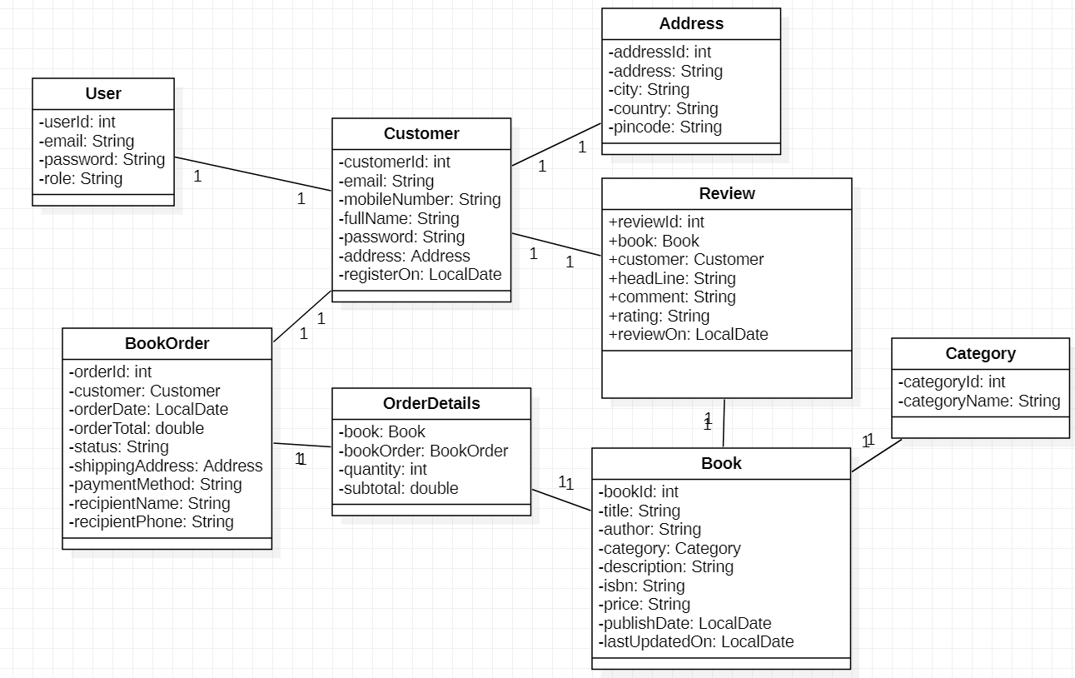
Class Diagram

Slide 7
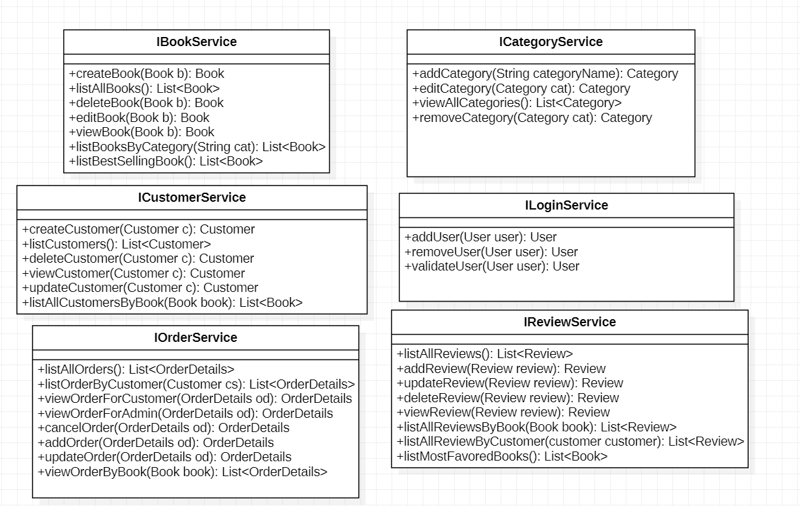
Service Interface

Slide 8

Repository

Slide 9


Slide 10
Thank You

